Slide 1
DNA Biopolymer Confinement and Escape
Bioengineering 230 Final Project Presentation Christopher J. Randolph Casey Hashimoto

Slide 2
Overview
Background
DNA and how it was fit into the model
Motivation
Basic Model Explanation
Objectives
(Experimental Set up)
Current State of Model
Future Directions

Slide 3
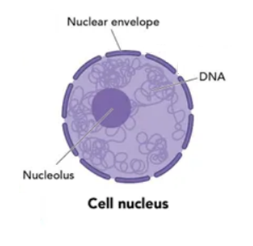

Background: Nucleus
DNA is stored in the nucleus
Generally, does not leave
Nuclear envelope keep DNA in while letting other biomolecules enter and exit

Slide 4
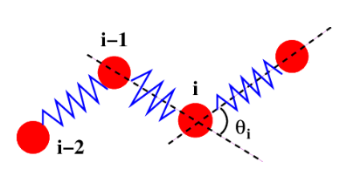
Ball and Spring Model
Chain: represents a double stranded DNA
Beads: represent a base pair
Springs: represent the bond between the bases
Θ: Change in direction of chain

Slide 5
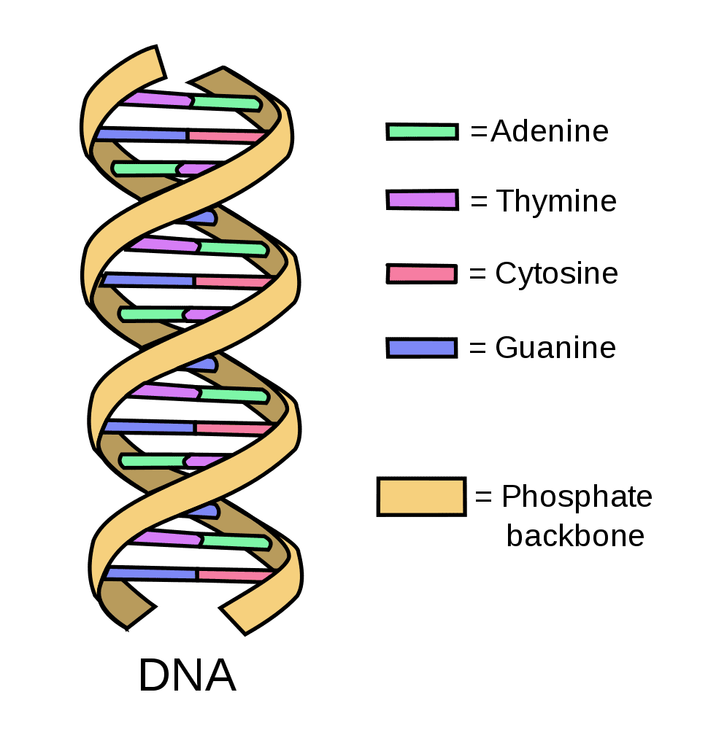

Background: DNA
DNA is a double helix
Model doesn’t include helicity
For future works

Slide 6
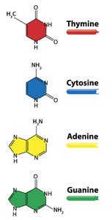

Background: Bases
DNA normally has 4 bases
Adenine, Thymine, Cytosine, Guanine
Model simplifies that
All base pairs become a single bead
No difference from one bead to next

Slide 7
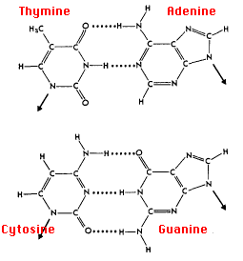
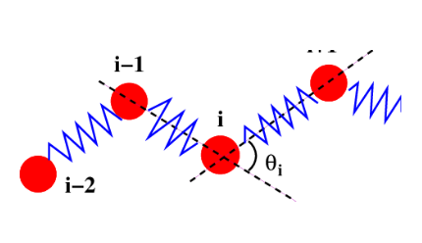

Background: Bonds
Compliment bases form hydrogen bonds
Instead of modeling a hydrogen bond we used springs
Set stiffness parameter to tweak ‘bond strength’

Slide 8
LAMMPS
Large-scale Atomic/Molecular Massively Parallel Simulator
Works by using spatial decomposition to partition simulation
Passes off partitioned section to processors which complete work in parallel

Slide 9
Motivation
Age and disease can cause the nucleus to have gaps in the membrane
DNA floating around can escape through these gaps
Which causes problems for the cell
Want to examine the percent of DNA that would be able to escape from a cell over a time frame to estimate potential damage

Slide 10
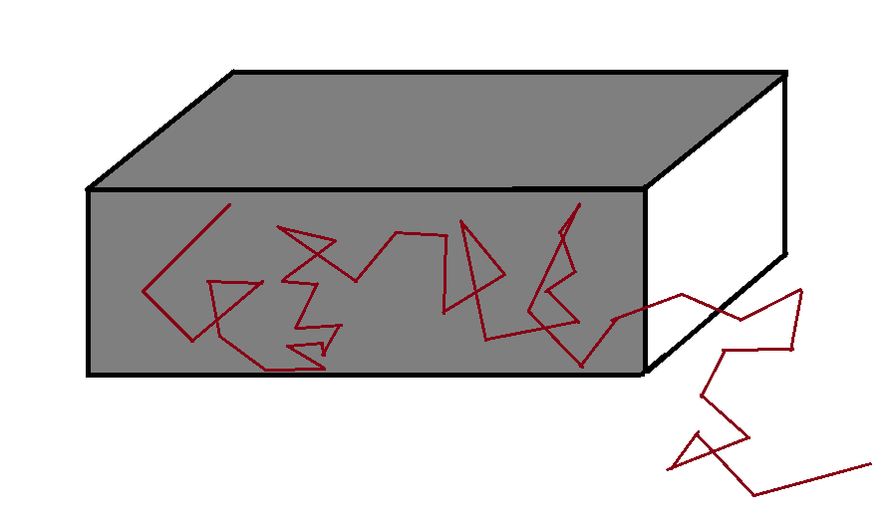
Basic Model Explanation
Confinement
Entire front face is open where DNA can escape
Rest of edges are solid
Notes:
The model is not drawn to scale

Slide 11
Objectives
Create a system with a DNA double helix with N beads connected by springs. This model will be confined in a region slightly wider than its width. The walls of the space will be attractive to the DNA and have a space where the DNA model can escape.
Run MD simulations on this system and determine the fraction of DNA that has escaped containment.
Modify the simulation to include solvent molecules of both charged and uncharged nature to determine the effects of solvent on the model movement.

Slide 12
Initial experiments
Our initial simulation was to make a simple polymer in a box.
The box was reflective but not exerting any long-range forces on the polymer.
The polymer had 50 monomers and was generated in an extended pattern.
This simulation was a proof of concept that helped us determine how to create a region and generate a polymer vector using a python script.

Slide 13
Wall Effects
To develop the model, we gave the walls long range influence on the polymer.
We tried both repulsive and attractive forces, but only repulsive forces are able to create a stable system.
When attractive forces are used, the polymer will intersect with the wall and cause a fatal error.

Slide 14
Adding Length
Our next step was to add monomers to the polymer.
To do this while maintaining a similar box size, we introduced a fold to the polymer's initial conformation.
This seems to introduce a semi permanent fold for this model, a zig-zag pattern would likely be better.

Slide 15
Current State of Model
Currently our model has repulsive walls on three sides, and we are looking to create a region where the DNA has “escaped.”
The model is confined to a region of 60 by 20 units and up to 108 segments.

Slide 16
Future Directions
First, we would like to generate a region to count as the “escape” location so we can quantify how much DNA is able to leave our box.
Following this we will be bringing the simulation up to three dimensions.
This will more closely relate to a real system.
We also would like to add in other polymers to interfere with the movement of the DNA.
Notes:
The nucleus has: RNA, mRNA, and tRNA in it so our model of not including them is not as accurate as it could be
The container attracts the DNA so varying the attractiveness would do a couple things
1. attract the DNA so forcefully no DNA can escape
2. facilitate DNA escape since the DNA would be pulled toward the walls (including where the gap is)
Since the gap is presumed to have appeared due to age or disease it is not impossible that multiple gaps could appear simultaneously

Slide 17
Questions

